Slide 1
Meeting 11/2

Slide 2
Agenda
Attendance
Brain Teasers
Split into Project Groups
Begin project

Slide 3

Attendance Form

Slide 4
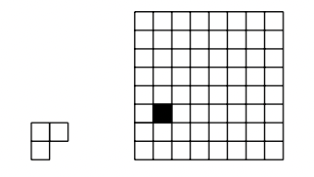
Brain Teasers
Show that a 2^{n}x2^{n} square with a single tile removed can be covered without overlaps by L-shaped figures, regardless of where the tile is removed.

Slide 5
Brain Teaser
We color each point in the plane either red, green, or blue. Show that there exists a rectangle in [0,1] x [0,1] with all four vertices the same color.

Slide 6
Brain Teaser
You and a friend play a game in which you each pick a sequence of three coin flips (Ex: THT) and then flip a coin until one of the chosen patterns shows up.
Your friend chooses the sequence HHH first. What sequence can you choose to have a 7/8 probability of winning?
What is an optimal choice if your friend chooses HTH first?

Slide 7
Brain Teaser
Consider three real numbers x,y,z. You know the following two pieces of information
xy < xz
y >z
Which of the following must be true
xyz > 0
xyz = 0
xyz < 0
More than one of the above statements could be true
There is not enough information

